Slide 1
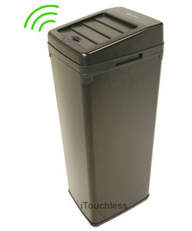
Solution
Are solution is making a trash can that can say “I only take recyclables items like cardboard, plastic bottles, and paper.

Slide 2
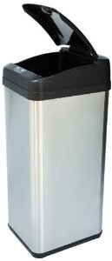
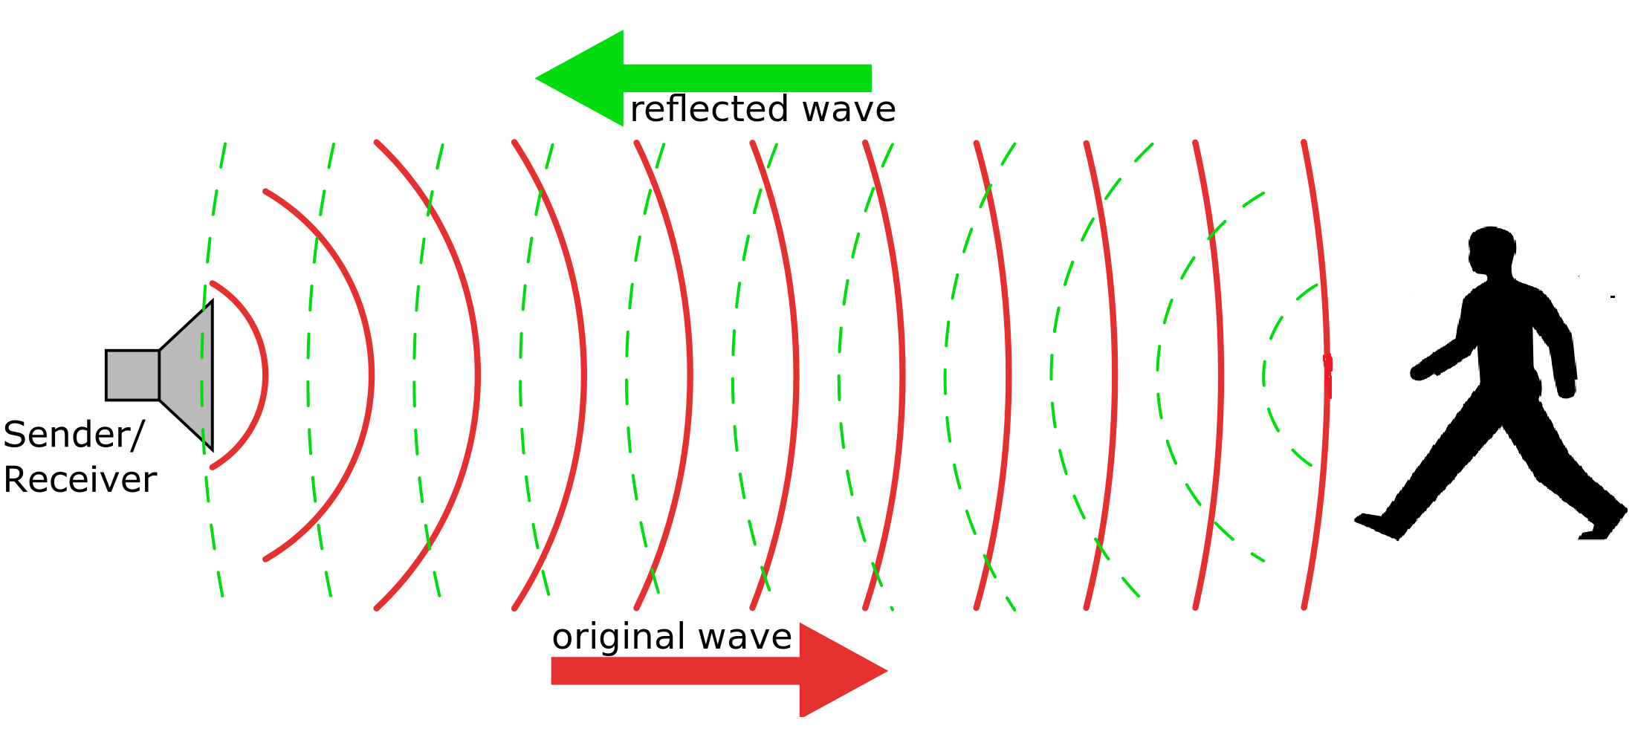
Solution
Another feature is a ultrasonic sensor to see if anybody is near.it will also detect buildings if they are too close.

Slide 3
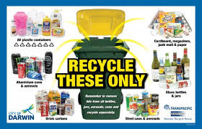
Solution
There also is going to be a sign for deaf people that has pictures of recyclable examples like this:

